Slide 1
Welcome to the experiment!

Slide 2
Experiment instruction
This experiment will have two sessions. On each trial, a cross sign will appear at the center of the screen to tell you that a new trial will start. Then a dot appears, which indicates the tones will be played soon.

Slide 3
Experiment instruction
This experiment will have two sessions. On each trial, a cross sign will appear at the center of the screen to tell you that a new trial will start. Then a dot appears, which indicates the tones will be played soon.
In the first session, we will hear either /ba/ or /pa/ on each trial, you will answer whether you hear /ba/ or /pa/ on each trial. Please make a response as quickly and correct as you can. Press F key on the keyboard by your left index finger if you hear /ba/. Press J key by your right index finger if you hear /pa/. If you are not sure, please make the best guess as you can.

Slide 4
Experiment instruction
This experiment will have two sessions. On each trial, a cross sign will appear at the center of the screen to tell you that a new trial will start. Then a dot appears, which indicates the tones will be played soon.
In the first session, we will hear either /ba/ or /pa/ on each trial, you will answer whether you hear /ba/ or /pa/ on each trial. Please make a response as quickly and correct as you can. Press F key on the keyboard by your left index finger if you hear /ba/. Press J key by your right index finger if you hear /pa/. If you are not sure, please make the best guess as you can.
In the second session, on each trial, you will hear a series of tones followed by a gap and a syllable. There will be a delay between the tones and the syllable. After listening to the syllable, please respond whether you hear /pa/ or /ba/. Please ignore the series of tones before the gap and focus on the syllable after the gap. Press F key on the keyboard by your left index finger if you hear /ba/. Press J key by your right index finger if you hear /pa/. If you are not sure, please make the best guess as you can.

Slide 5
Experiment instruction
You will have a chance to take a break every ten minutes during the experiment. You can take a break when the “Take a break” text is displayed on the screen. It’s up to you to take a break or keep doing the experiment. It’s also up to you for how long you want to rest. If you want to continue without taking a rest, just press space key on the keyboard to go on. The experiment will be about an hour, but it will also depend on how long your breaks and reaction times are. Please let me know when you finish the main task. I will come in and help you fill out two questionnaires popped up on the screen.

Slide 6
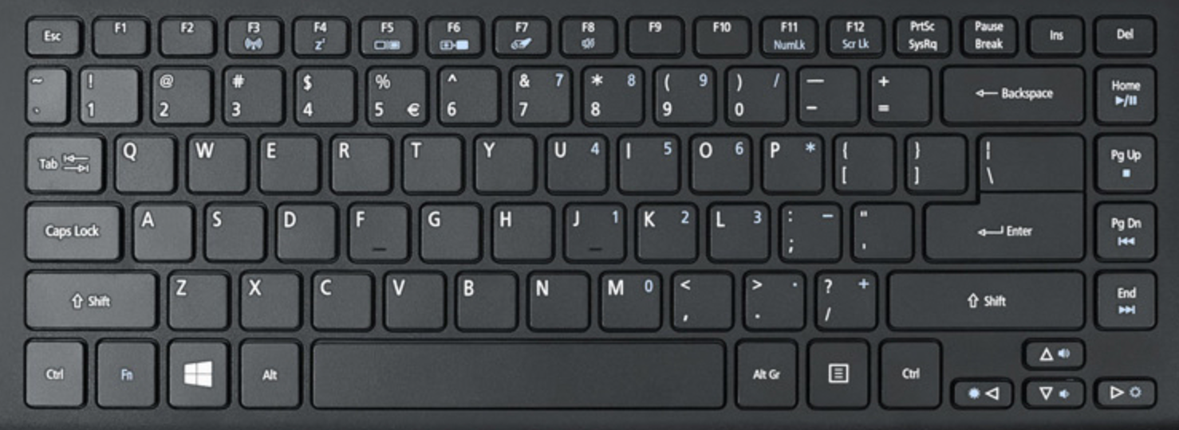
Identification task
/ba/

Slide 7
Identification task
/pa/

Slide 8
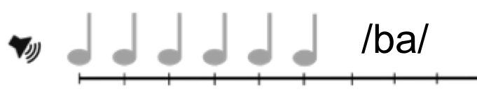
Main task

Slide 9
Main task

Slide 10
Main task
/pa/

